Slide 1
Hierarchy of Controls
Heart of Hearts
Put it into action!

Slide 2
Scenario
Describe the scenario here.
Add a picture to depict the scenario
In groups, analyze this fatality and prepare to report hazards and an assessment of which HoC level each best practice represents.

Slide 3
Hierarchy of Controls Cards
Personal Protective
Administrative
Engineering
Substitution
Equipment
Elimination
1
2
3
4
5
LEAST EFFECTIVE
MOST EFFECTIVE
Protect the worker with personal protective equipment | Change the way work is performed | Isolate workers from the hazard | Replace the hazard | Physically remove the hazard

Slide 4
Best Practices – Scenario | Identify the Control(s)
Best practice 1
Best practice 2
Best practice 3
Best practice 4
Best practice 5

Slide 5
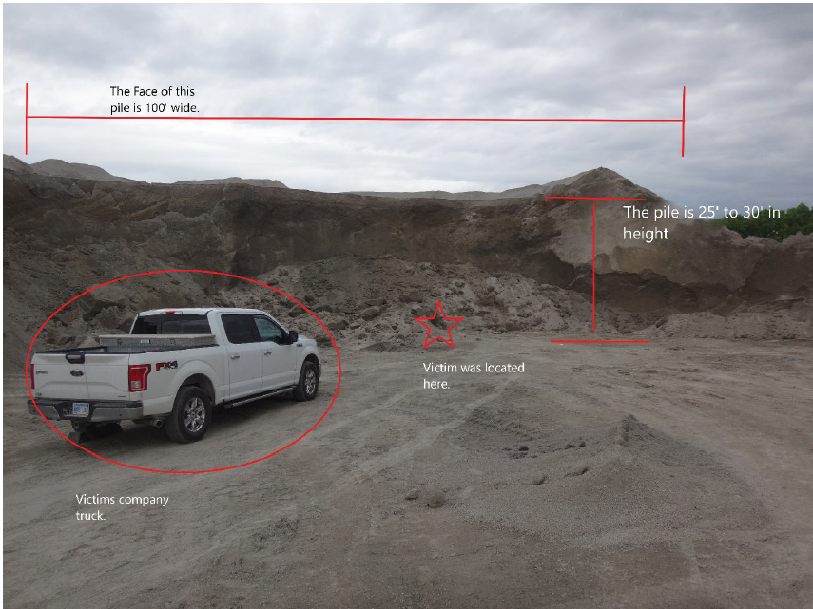
Engulfment Fatality
Example Scenario
On June 19, 2020, a miner died while inspecting a stockpile for oversized material. As the victim walked along the toe of the stockpile, a portion of the stockpile collapsed, covering him with approximately four feet of material.
In groups, analyze this fatality and prepare to report hazards and an assessment of which HoC level each best practice represents.

Slide 6
Hierarchy of Controls Cards
Personal Protective
Administrative
Engineering
Substitution
Equipment
Elimination
1
2
3
4
5
LEAST EFFECTIVE
MOST EFFECTIVE
Protect the worker with personal protective equipment | Change the way work is performed | Isolate workers from the hazard | Replace the hazard | Physically remove the hazard

Slide 7
Best Practices – Engulfment Fatality | Identify the Control(s)
Establish and discuss safe work procedures before beginning work. Identify and control all hazards associated with the work to be performed and the methods to properly protect persons.
Task train everyone to recognize potentially hazardous conditions that can decrease bank or slope stability and ensure they understand safe job procedures for eliminating hazards.
Stay clear of potentially unstable areas. Barricade the toe area to prevent access where hazards have not been corrected.
Oversteepened slopes may be flattened from the top of the stockpile by using a bulldozer to gradually cut down the slope. Construct stockpiles in a manner to eliminate vertical heights that require undercutting.
Promptly notify miners that the stockpile area could adversely affect safety or health.
Notes:
Engulfment Fatality –
Administrative – Procedures and performing inspections. Controlling all associated hazards can be achieved by any of the methods.
Administrative – Training
Engineering – Barricading, but not eliminating
Engineering – by bulldozing, Elimination of vertical heights.
Administrative – Notification/training

